Slide 1

Week#1
CS3009 - Software Engineering (Spring’25)
Saba Naseem
saba.naseem@nu.edu.pk

Slide 2
Reference Books
I. Sommerville, Software Engineering, 9th Edition, Pearson Education, 2011.
Software Engineering, A Practitioner’s Approach, Pressman R. S.& Maxim B. R., 8th Edition, McGraw-Hill, 2015

Slide 3
Course Objective
Upon successful completion of this course the student will be able to apply software engineering techniques effectively to produce a successful software product.
They will be able to structure the software production process, analyze the requirements for a software system, produce a software design and architecture from requirements.
The course should also introduce the students to software project management and planning issues and various software validation and verification techniques.

Slide 4
Course Outline
Weeks | Contents/Topics | **Courseware Events
Week-01 | Introduction to Software Engineering Software Development Life Cycle | Reading Task
Week-02 | Software processes | Assignment Quiz
Week-03 | Software processes Software Requirement Engineering, | Reading Task
Week-04 | Requirement Analysis, Requirement Specification, Requirement Validation, Requirement Management | Deliverable
Week-05 | Software Design | Quiz Deliverable
Week-06 | Software Design Patterns (Gang Of Four) | Reading Task
Week-07 | Software Architecture | Reading Task Quiz
Week-08 | Architectural Styles

Slide 5
Course Outline
Week-09 | Software Project Management Activities | Deliverable
Week-10 | Software Project Plan | Deliverable
Week-11 | Software Project Activity Planning | Quiz
Week -12 | Project Monitoring And Control , Cost Estimation | Deliverable
Week 13 | Software Quality Assurance , Quality Planning | Reading Task
Week-14 | Software Testing | Deliverable Quiz
Week-15 | Software Testing | Deliverable
Week-16 | Software Configuration Management, Evolution & maintenance | Reading Task

Slide 6
What is Software?

Slide 7

What is Software?
Software
Computer instructions or data
Software
Program
Data
Documentation

Slide 8

What is Engineering?
What is Engineering?
“The process of productive use of scientific knowledge is called Engineering.”

Slide 9


Software Engineering
What is Software Engineering?
Application of systematic, disciplined, quantifiable approach to development, operation and maintenance of software. (IEEE-Std.)
Notes:
It is the process of creating software in a systematic, organized, and measurable way. This ensures the software is reliable and meets the users' needs.
Systematic: Following a well-planned and structured approach.
Disciplined: Using established methods and rules to avoid errors.
Quantifiable: Measuring progress and quality at each step.

Slide 10
Difference Between CS and SE
Difference b/w CS and SE
“ This is the process of utilizing our knowledge of computer science in effective production of software systems.”

Slide 11

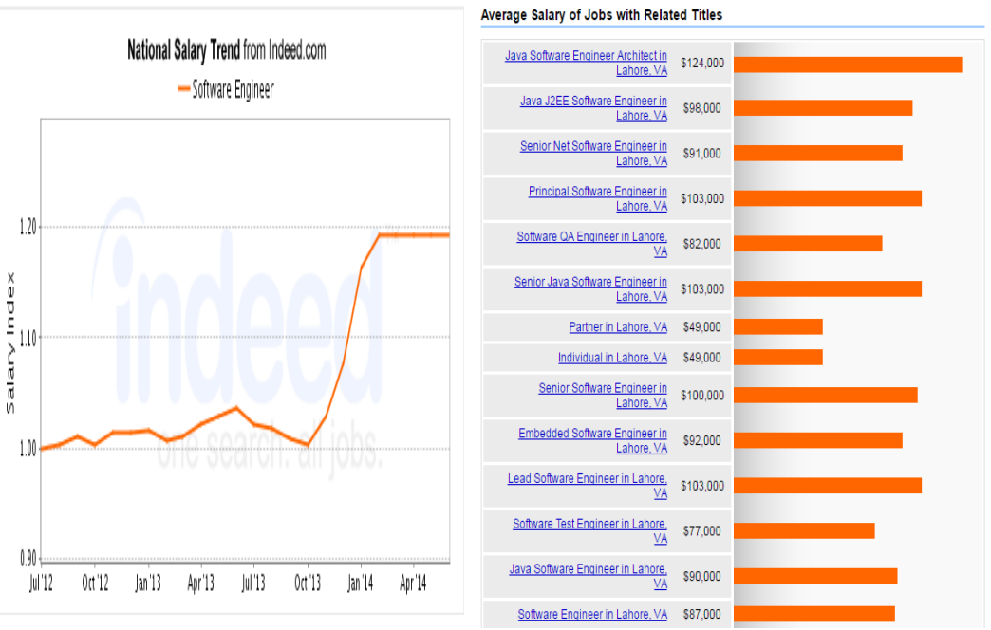

Slide 12
Challenges
“Software is like a werewolf, it looks normal until the moon comes out and it turns into a monster”
Missed deadlines
Over budget
Buggy software
Unfortunately “No Silver Bullet” is there to hunt this “Monster”
Visit http://www5.in.tum.de/~huckle/bugse.html and see the bugs collection.

Slide 13
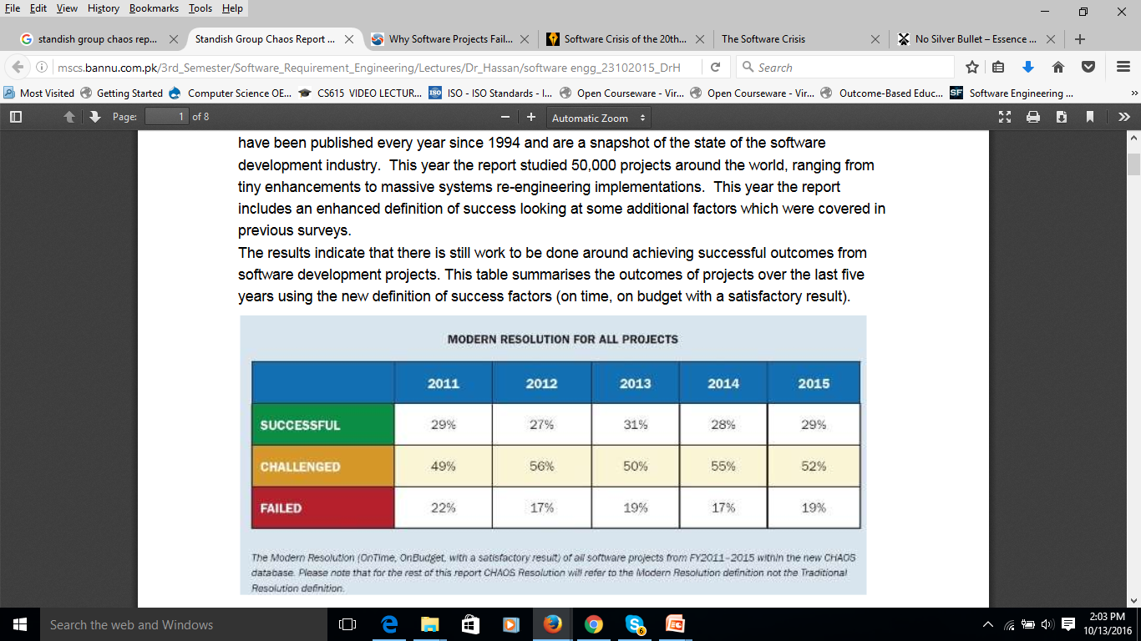
Software Projects
Only 29% of software projects were successful, 52% challenged (cost, budget overruns or content deficiencies) and 19% cancelled
There is still work to be done around achieving successful outcomes

Slide 14
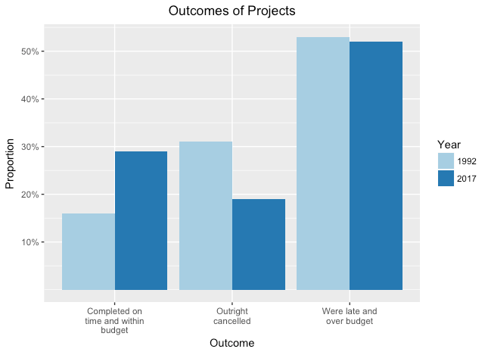
Software Projects

Slide 15
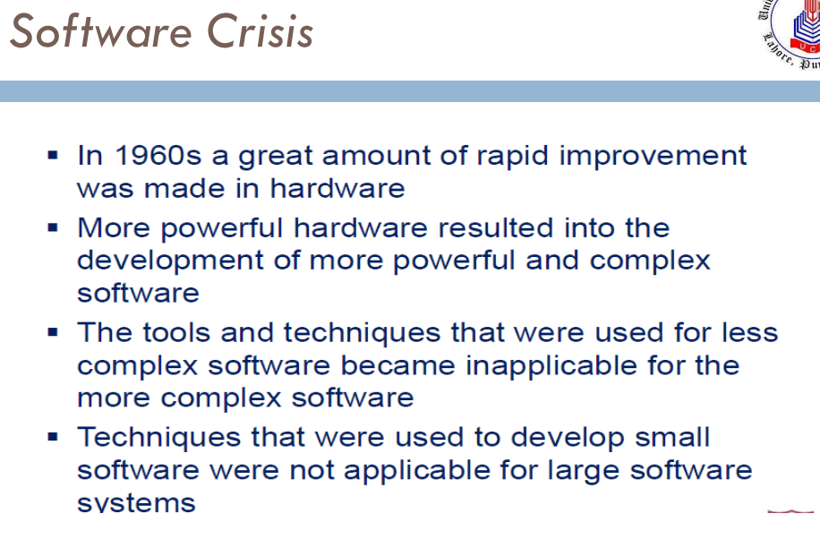

Slide 16
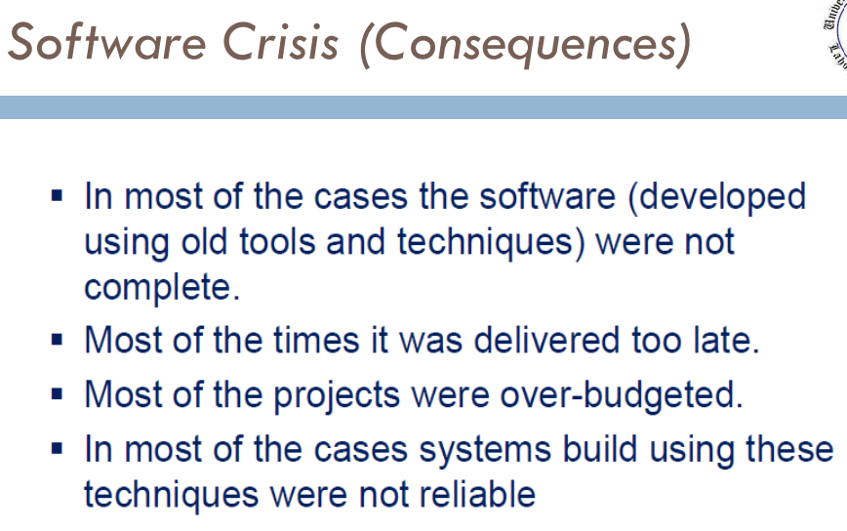

Slide 17
Problems in software development
Common issues
The final software does not fulfill the needs of the customer
Hard to extend and improve: if you want to add a functionality later its mission impossible
Bad documentation
Bad quality: frequent errors, hard to use, ...
More time and costs than expected

Slide 18
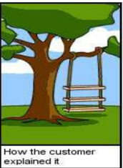
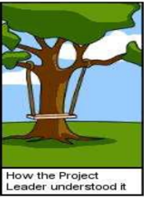
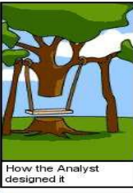
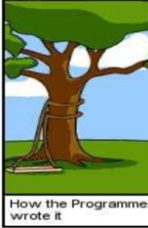

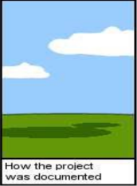
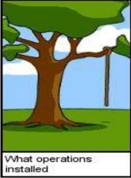
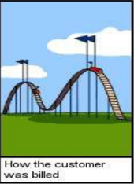
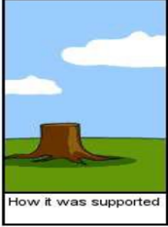
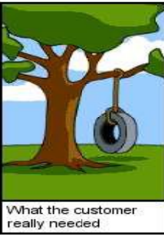

Slide 19
Importance of Software
Society is becoming increasingly dependent on software components e.g.
electronic devices (microwave oven, washing machine etc.),
vehicles (cars, buses etc.),
mission critical systems (missiles, aircrafts etc.),
medical machines → increased complexity because of embedded software.
Maintaining reliability in software-intensive systems is very difficult.
System Complexity
Time

Slide 20
Software Bugs
History of software bugs
Softwares encountered notorious bugs that were the cause of financial lose and deaths of many people.
Famous bugs
Therac-25 (1985-1987)
A bug in the code controlling the Therac-25 radiation therapy machine was directly responsible for at least five patient’s death in the 1980s when it administered excessive quantities of X-rays.
Reading http://sunnyday.mit.edu/papers/therac.pdf

Slide 21
Software Bugs
Ariane 501
On 4 June 1996, the Ariane 501 satellite launch failed terribly 40 seconds after initiation of the flight sequence, incurring a direct cost of approximately $370 million.
Reason: Specification and design errors in the software.
Reading: The ARIANE 5 Software Failure, Mark Dowson, Software Engineering Notes, vol. 22 no. 2, pp. 84. & http://sunnyday.mit.edu/accidents/Ariane5accidentreport.html

Slide 22
Software Bugs
The Millennium Bug, or Y2K
Two digits were used to show the date, e.g., 98 instead of 1998, the year 2000 could only be represented as ’00′, which might confuse computers into thinking it meant the year 1900.
Pentium bug
Software error in microcode of Pentium microprocessor, which resulted in error of floating-point calculations problems.
Intel had to take back all the Pentiums, and it caused huge loss of dollars.

Slide 23
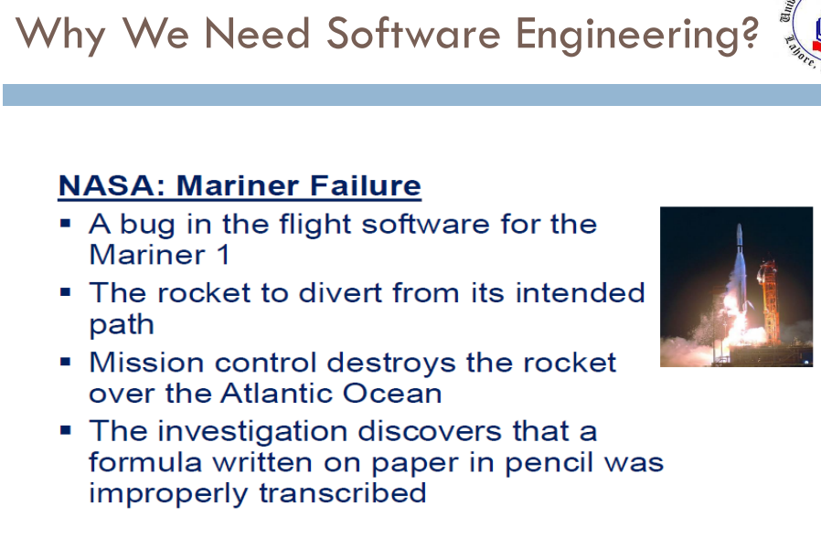

Slide 24
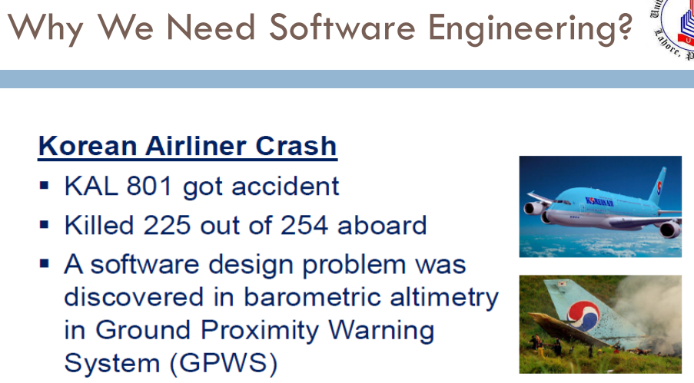

Slide 25
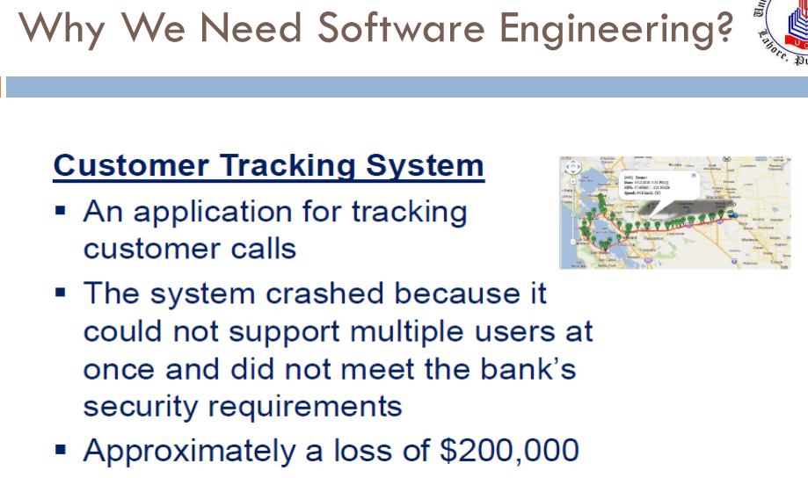

Slide 26
Well-Engineered Software
Reliable
Good User Interface
Acceptable Performance
Good Quality
Cost Effective

Slide 27
Goals of Software Engineering
Constructing software is a challenging task, essentially because software is complex.
The perceived problems in software development and the goals that software development seeks to achieve are:
Meeting users’ needs
Low cost of production
High performance
Portability
Low cost of maintenance
High reliability
Deliver on time

Slide 28
Software Engineering Diversity
Stand-alone applications
Interactive transaction-based applications
Embedded control systems
Batch processing systems
Entertainment systems
Systems for modeling and simulation

Slide 29
Software Engineering Diversity
Stand-alone applications:
Application systems that run on a local computer, such as a PC
Include all necessary functionality and do not need to be connected to a network
Examples are Office on a PC, CAD programs, photo manipulation software, Notepad, Calculator etc.

Slide 30
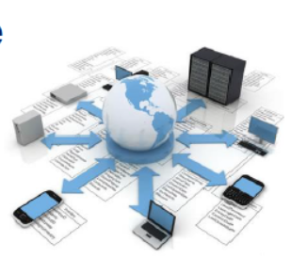
Software Engineering Diversity
Interactive transaction-based applications
Applications that execute on a remote computer and that are accessed by users from their own PCs
Include web applications such as e-commerce applications
This class of application also includes business systems, where a business provides access to its systems through a web browser or special-purpose client program and cloud-based services, such as mail and photo sharing

Slide 31
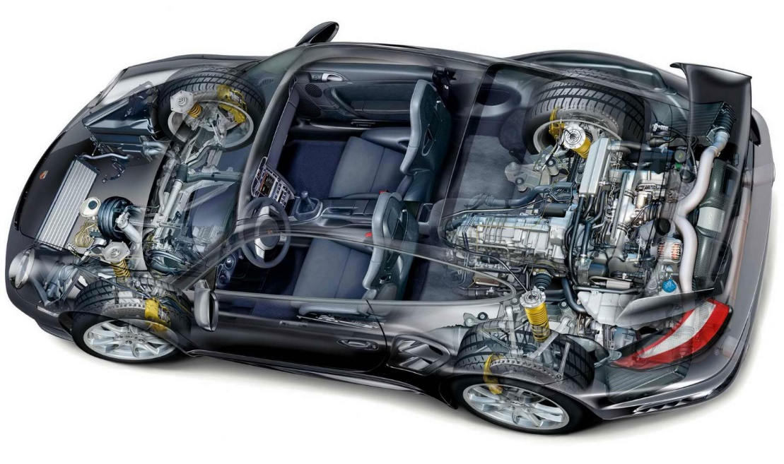
Software Engineering Diversity
Embedded control systems
Software control systems that control and manage hardware devices
More embedded systems than any other type of system
Examples of embedded systems include
Software in a mobile (cell) phone
Software that controls anti-lock braking in a car
Software in a microwave oven to control the cooking process

Slide 32
Software Engineering Diversity
Batch processing systems
Business systems that are designed to process data in large batches
Process large numbers of individual inputs to create corresponding outputs
Examples of batch systems include
Billing systems
Salary payment systems.

Slide 33
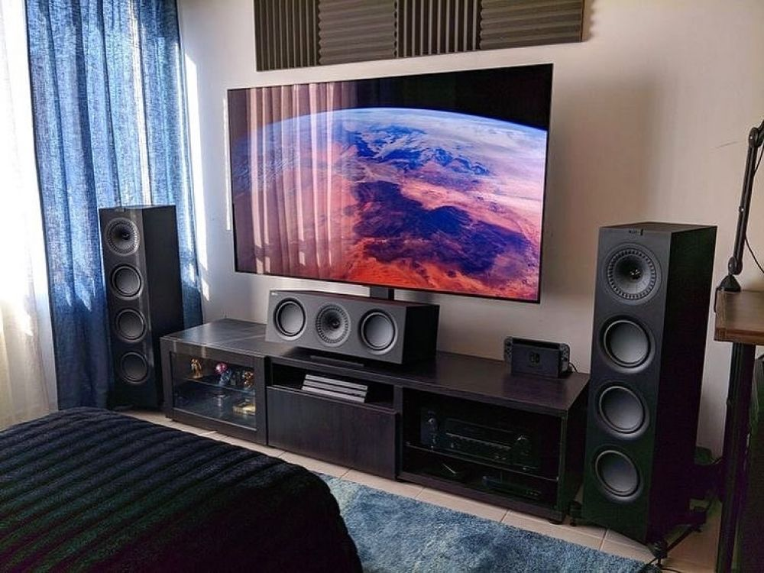
Software Engineering Diversity
Entertainment systems
Systems that are primarily for personal use and which are intended to entertain the user
Most of these systems are games of one kind or another
The quality of the user interaction offered is the most important distinguishing characteristic of entertainment systems

Slide 34
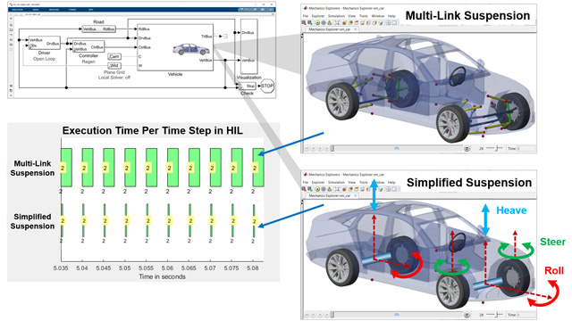
Software Engineering Diversity
Systems for modeling and simulation
Systems that are developed by scientists and engineers to model physical processes or situations
Are often computationally intensive and require high-performance parallel systems for execution

Slide 35
Software Products
Generic Products
Customized products

Slide 36
Software Process
A structured set of activities required to develop a software system
Specification
Design and Implementation
Verification & Validation
Evolution
Specification
Design and Implementation
Validation
Evolution

Slide 37
Four fundamental activities of software Process
Any software process must include the following four activities:
Software specification (or requirements engineering):
Defining what the software should do. Main functionalities of the software and the constrains around them are specified.
Software design and implementation:
Defining the software and data organization and implementing the system. The software is to be designed and programmed in this activity.

Slide 38
Four fundamental activities of software Process
Software verification and validation:
Testing the system for bugs and conformance to requirements. The software must conforms to it’s specification and meets the customer needs.
Software evolution (software maintenance):
Changing the system after it has gone into use. The software is being modified to meet customer and market requirements changes.

Slide 39
Software Development Life cycle (SDLC)
The software life cycle is the sequence of different activities that take place during software development.
There are also different deliverables produced.
Although deliverables can be agreements or evaluations, normally deliverables are objects, such as source code or user manuals.
Usually, the activities and deliverables are closely related.
Milestones are events that can be used for telling the status of the project.

Slide 40
SDLC
Feasibility
—Determining if the proposed development is worth-while.
Market analysis
—Determining if there is a potential market for this product.
Requirements
—Determining what functionality the software should contain.
Requirement elicitation
—Obtaining the requirements from the user.
Domain analysis
—Determining what tasks and structures are common to this problem.
Project planning
—Determining how to develop the software.
Cost analysis
—Determining cost estimates.
Scheduling
—Building a schedule for the development.
Software quality assurance plan
—Determining activities that will help ensure quality of the product.
Work-breakdown structure
—Determining the subtasks necessary to develop the product

Slide 41
SDLC (cont)
Design
—Determining how the software should provide the functionality.
Architectural design
—Designing the structure of the system.
Interface design
—Specifying the interfaces between the parts of the system.
Detailed design
—Designing the algorithms for the individual parts.
Implementation
—Building the software.

Slide 42
SDLC (cont)
Testing
—Executing the software with data to help ensure that the software works
correctly.
Unit testing
—Testing by the original developer.
Integration testing
—Testing during the integration of the software.
System testing
—Testing the software in an environment that matches the operational environment.
Alpha testing
—Testing by the customer at the developer’s site.
Beta testing
—Testing by the customer at the customer’s site.
Acceptance testing
—Testing to satisfy the purchaser or SQA team.
Regression testing
—Saving tests from the previous version to ensure that the new version retains the previous capabilities.
Stress testing
— Testing to make sure application work under stress (a lots of inputs for
example)

Slide 43
SDLC (cont)
Delivery
—Providing the customer with an effective software solution.
Installation
—Making the software available at the customer’s operational
site.
Training
—Teaching the users to use the software.
Help desk
—Answering questions of the user.
Maintenance
—Updating and improving the software to ensure continued usefulness.

Slide 44
Reference
Chapter 1, I. Sommerville, Software Engineering, 10th Edition, Pearson Education, 2011.

